Slide 1


2023
PROPERTY ADDRESS OR NAME
DESCRIPTION SHOULD TYPICALLY INCLUDE THE STRATEGY, ASSET TYPE, ANY DEVELOPMENT POTENTIAL, AND LOCATION
$150M | $75M | 9.4% | 1.6x | 6 years | $120M
Purchase Price | Total Equity | Net LIRR | Net EM | Hold Period | Profit

Slide 2


Executive Summary
Transaction Background
Describe the specific property to be acquired, its size in SF and acres, location, submarket, and current status.
Share the previous challenges or roadblocks faced by other potential buyers and/or prior ownership.
Explain how your company secured the deal and your strategies to mitigate possible issues, including any unique acquisition methods or due diligence steps.
Base Case Strategy
Outline your company's proposed strategy for the property and any key tenants.
Provide an estimated timeline for the construction and occupancy phases if a development, value-add, or lease-up property.
Detail the projected financial returns, including key metrics like Net LIRR, Net EM, initial equity distribution, acquisition loan details, and exit cap rate assumptions.
Elaborate on the valuation method used for the asset (both entry and exit) and how this influences your exit strategy.
Submarket Description and Detail any Additional Upside
Highlight the strategic location of the property and the current state of the submarket.
Reiterate the conservative assumptions behind your projected returns and the exclusion of the upside scenario.
Describe the most probable exit scenario, including who might buy the property and when.
Discuss the financial advantage of your initial purchase price combined with potential interim yields in the submarket before the expected exit.

Slide 3
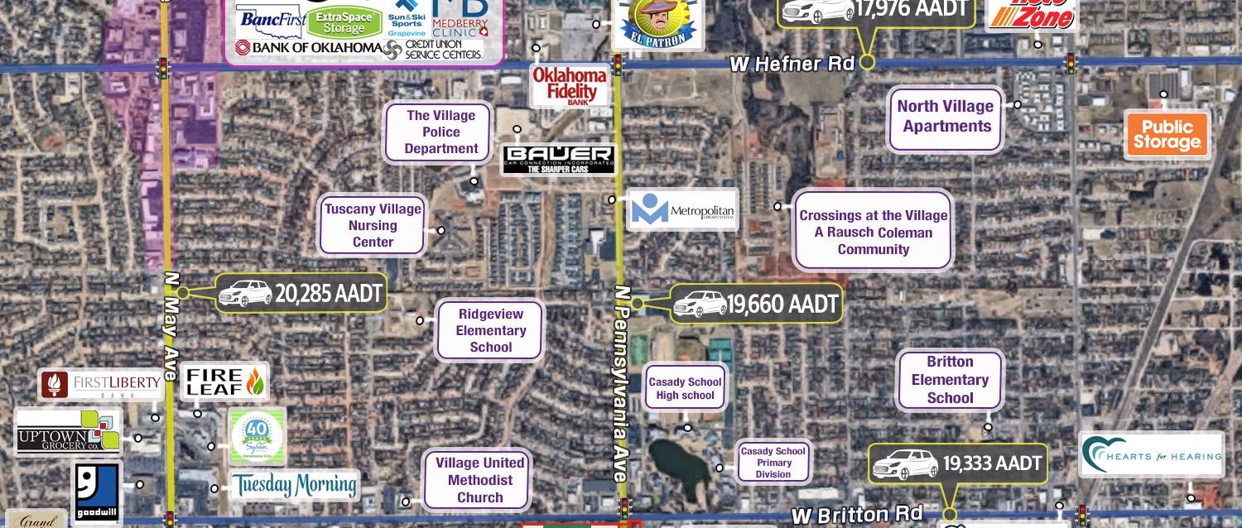
Area Map with Competitive Overview
THE AREA MAP WITH COMPETITIVE OVERVIEW WILL DIFFER BY PRODUCT TYPE – RETAIL MAY FOCUS ON COMPETITORS, DEVELOPERS MAY FOCUS ON OTHER LARGE PLAYERS THAT ARE CORNERING THE LOCAL MARKET, ETC. – BELOW EXAMPLE IS RETAIL

Slide 4

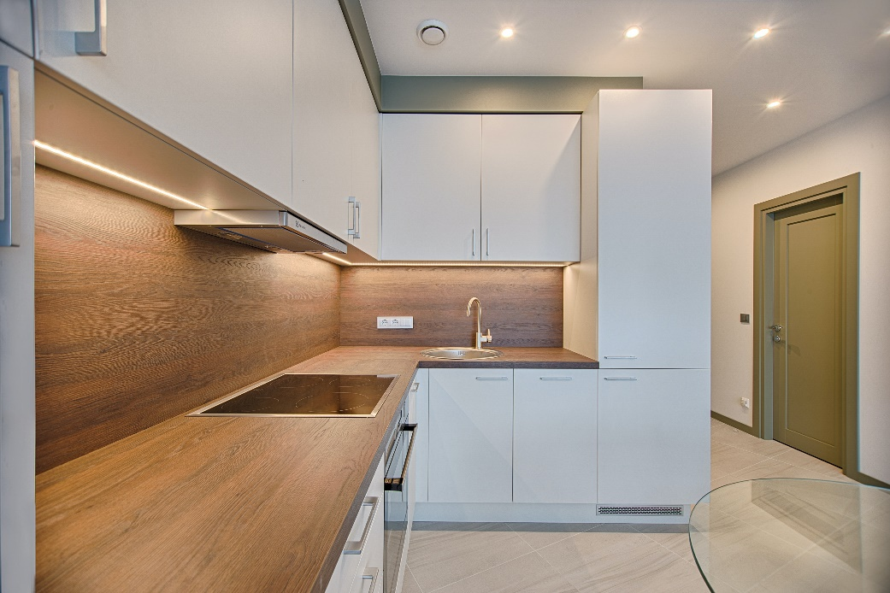
Property Highlights
Project History and Acquisition
Present the history of the property, its size, location, and its history including any previous contractual obligations or recent transactions prior to yours.
Explain the seller's current state and their plans post-closing.
Discuss any potential challenges related to the project development or acquisition, including any delayed closings or other issues.
If relevant, discuss any relevant local political factors such as entitlements and recent city council activity
Acquisition Structure
Share the competitive state of the market and how your company has managed to secure the deal.
Explain the structure of the acquisition, highlighting any innovative strategies used to avoid potential complications.
Provide details of the acquisition price and any associated costs or negotiations.
Project Developers and Experience
Highlight your team's track record and experience in managing similar projects.
Detail the current stage of the project, including any recent milestones achieved or upcoming steps.
Provide an estimated timeline for construction, occupancy, and rental commencement.
Financial Targets and Strategy
Outline the financial strategy, including the intended use of the property and any key tenants.
Share anticipated financial returns, detailing key metrics such as cash-on-cash returns, cap rates, IRR, NPV, etc.
Discuss any additional financial opportunities not included in the base case projections.

Slide 5
Transaction Summary
CALL OUT KEY METRICS OF THE UNDERWRITING SUCH AS CAP RATE AND FEEL FREE TO ALSO NOTE KEY STRATEGIC OBJECTIVES, E.G. VALUE ADD, YIELD PLAY, ETC. NUMBERS BELOW ARE ILLUSTRATIVE FOR PRESENTATION PURPOSES ONLY AND DO NOT REFLECT REAL DEAL TERMS.
Numbers are illustrative for presentation purposes only and do not tie out across the presentation. In a real investor memo, they should definitely all tie out everywhere.

Slide 6
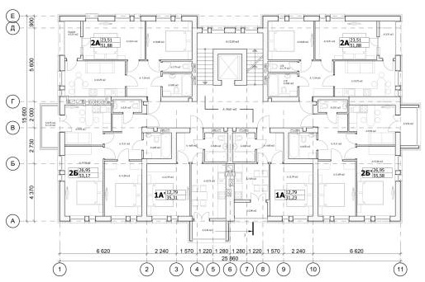
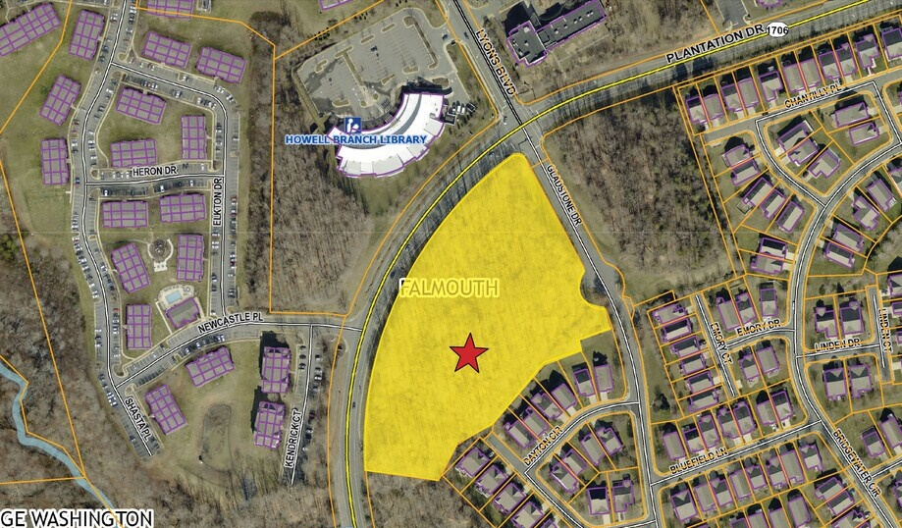
Operational Assumptions
Feasibility and Cost Assumptions
Discuss the various phases of development and indicate who is responsible for feasibility and cost estimates.
Detail the proposed layout of the property and the intended use for each space, including the lease term, rental rates, and tenant improvement (TI) allowance for each suite.
Share specific design or construction strategies that take advantage of the property's existing features.
Financial and Lease Assumptions
Outline the landlord's expected expenses, including capex costs and TI allowances.
Compare the assumed rental rates to current market rates in the local submarket.
If applicable, share any validation of the rental rates from key tenants or based on comparable properties.
Lease Occupancy and Capex Assumptions
Explain any terms related to additional TI needs and the related return on investment.
Provide projected occupancy dates for key tenants and overall property, including assumptions about construction timelines and lease-up periods.
Discuss any allowances or concessions included in your lease assumptions.
Investment Assumptions
Detail the total anticipated initial capital expenditures and additional investments, including tenant improvements and leasing commissions.

Slide 7
Historical and Pro Forma Deal Timeline
FEEL FREE TO INCLUDE A CALL-OUT BOX HERE OR YOU CAN JUST DELETE IT. IT ISN’T ALWAYS NECESSARY UNLESS THERE’S SOMETHING SPECIFIC ABOUT THIS TIMELINE YOU’D LIKE TO FLAG TO YOUR AUDIENCE
Past Specific Date (Mmm ‘YY)
Callout events on the timeline
Using boxes like this
The dark boxes can represent dates that are in the past
The light boxes can represent dates that are in the future
You can use straight lines like the one under this box to indicate specific dates
Future Period (Mmm ’YY – Mmm ’YY):
The light blue dates indicate future periods
Great for calling out time periods such as construction, lease-up, etc.
Specific Future Date (Mmm ’YY):
The line under this box indicates a specific date
Jan ’23 | Feb ’23 | Mar ’23 | Apr ’23 | May ’23 | Jun ’23 | Jul ’23 | Aug ’23 | … | May ‘24 | … | Dec ‘24
Historical Period (Mmm ‘YY – Mmm ‘YY):
The curly brace indicates a period of time
Again, dark blue indicates events in the past
Future Period (Mmm ’YY – Mmm ’YY):
Feel free to have periods overlap
Hopefully you can fit everything in by using the top and bottom boxes
If not, feel free to extend the timeline to another page
Callout (Mmm ’YY)

Slide 8
Risks and Mitigants
Risk | Mitigant
Risk 1 | The Risk & Mitigants section of a real estate investor memo is crucial because it helps potential investors understand the potential challenges or uncertainties associated with the investment, and how the investment team plans to address or mitigate those risks.
Risk 2 | Some of the risks in a real estate investment can include market risks (such as changes in the economy or real estate market conditions), specific project risks (like construction delays or cost overruns), regulatory risks (including changes in zoning or environmental regulations), and financial risks (such as changes in interest rates or difficulties securing financing).
Risk 3 | By explicitly outlining these risks and their mitigation strategies, the team demonstrates a thoughtful and realistic understanding of the project. This not only provides transparency to investors, but also fosters trust and confidence in the team's ability to navigate potential hurdles and deliver on the investment's objectives.
Risk 4 | Further, discussing mitigants signals to the investor that the team is proactive, not just reactive, about potential risks. These could include things like securing insurance, performing thorough due diligence, using experienced contractors, or having contingency funds in place.
… | …
Risk n | Overall, this section is a vital part of the decision-making process for investors, as it helps them assess the risk-reward balance of the investment and make an informed decision.

Slide 9
Investor Partnership Summary
The contents of this slide are entirely dependent on the investment fund generating this memo
The slide might include the total equity anticipated, timing of capital calls, the closing date, the legal structure of the units the investors should receive, and relevant footnotes on those subjects
This page should also clearly outline any fees associated with the investment, so your audience knows how the LPs will pay their GPs
If you are employing a waterfall, you should also include the relevant pref return and subsequent hurdles and splits
Your investors should clearly understand how they’re paying you and it is helpful to include exemplary return scenarios for their benefit to understand the differential between the gross and the net given various outcomes
Your memo should also make your investors aware when they should expect any money back – for instance, a development may take longer to return funds than a stabilized cash yield asset

Slide 10
Sponsor Overview
Primary Sponsor
Introduce the primary sponsor, its area of expertise, and overall experience in real estate investments.
Highlight key financial achievements including total value of managed real estate and investor capital across various asset classes.
Mention landmark projects and successes, citing the type of projects, location, and any notable elements.
Explain the sponsor's focus areas, team synergy, and history of joint venture projects.
Discuss the sponsor's investment strategy, including buy-and-hold approach, use of leverage, and long-term objectives.
Co-Sponsor or Partner
Introduce the co-sponsor or partner organization, their relationship with the primary sponsor, and their role in the current project.
Detail the experience and background of the co-sponsor's key personnel, including their past leadership roles and project experience.
Highlight the co-sponsor's wide-ranging experience in diverse real estate product types and high-profile projects.
Cite examples of successful projects led by the co-sponsor, including retail and office spaces, mixed-use developments, build-to-suit properties, and more.
Feel free to use logos and arrange this slide in a column-wise format. Whatever works. These are just the concepts you should seek to address. The goal is to sell your audience on why your firm is the best fit for this project.

Slide 11
Deal Team
Primary Sponsor
Introduce the organization leading the deal, its expertise, and role in the project.
Deal and Tax Counsel
Highlight the law firm or lawyer providing advice on deal structuring and taxation.
Tax and 1031 Advisory
Detail the advisor(s) providing guidance on tax strategies, including 1031 exchanges.
Land Use and Local Regulatory Counsel
Mention the local attorney specializing in zoning, land use, and local regulations.
Project Management/Owner's Representative
Identify the person or team responsible for overseeing the project's execution on behalf of the owner.
General Contractor (GC)
Introduce the organization responsible for the actual construction of the project.
Architecture and Engineering
Specify the architectural and engineering firm(s) tasked with designing and engineering the project.
Mechanical, Electrical, and Plumbing (MEP) Engineer
Highlight the engineering firm or individual providing expertise on the building systems.
Project Specialist(s)
Name any specialists hired for unique aspects of the project, such as sustainability consultants, traffic consultants, or market study firms.
Additional Roles (if applicable)
Lender or Financing Partner: The bank or financial institution providing the loan or funding for the project.
Leasing Agent: The person or firm responsible for securing tenants for the project.
Property Manager: The person or firm responsible for day-to-day operations once the project is completed.
Environmental Consultant: The professional providing guidance on environmental regulations and potential site contamination issues.
Marketing and PR: The firm or individual responsible for promoting the project to potential tenants and the wider community.

Slide 12
Post-Investment Expectations
Tax Benefits
Detail any specific tax benefits to be pursued, such as Bonus Depreciation or cost segregation studies, and what that could mean in practical terms for the investor (e.g., estimated tax losses).
Distribution Schedule
Provide an overview of how and when returns will be distributed to investors. Include details about the frequency of payments and anticipated timing for when the asset will start generating regular cash flow.
Capital Events
Discuss possible capital events such as refinancing, sale, or additional financing rounds. Provide an expected timeline for these events if possible.
Return of Capital
Clarify under what circumstances investors could expect a return of their initial capital. This might include information about refinancing, property sale, or income generation from the asset.
Communication and Reporting
Describe how often investors can expect updates on the project's progress and financial performance. Outline the format these updates might take (e.g., written reports, conference calls, meetings).
Risk Management
Briefly touch on the strategies for managing potential risks associated with the investment. This might involve diversification strategies, use of insurance, or active risk monitoring practices.
Exit Strategy
Discuss the projected exit strategy for the investment. This might be a property sale, refinancing, or another form of capital event. Provide a timeline for the exit strategy if possible.
Investment Growth
Discuss the potential for investment growth over time, including estimates for appreciation, rent increases, or other factors that could increase the value of the investment.
Responsiveness to Market Conditions
Assure investors that the strategy may adjust based on market conditions to ensure optimal returns and mitigate risks. This could involve refinancing, property upgrades, or other strategic shifts.

Slide 13
Appendix

Slide 14
Annual Cash Flows

Slide 15
Leasing Comparables
ASSUMING YOUR PROPERTY HAS LONG-TERM LEASES (E.G., NOT JUST A STRICTLY MULTIFAMILY BUILDING), YOU SHOULD JUSTIFY YOUR LEASING ASSUMPTIONS USING LEASING COMPAABLES, WHICH ARE TYPICALLY OBTAINED FROM A BROKER

Slide 16

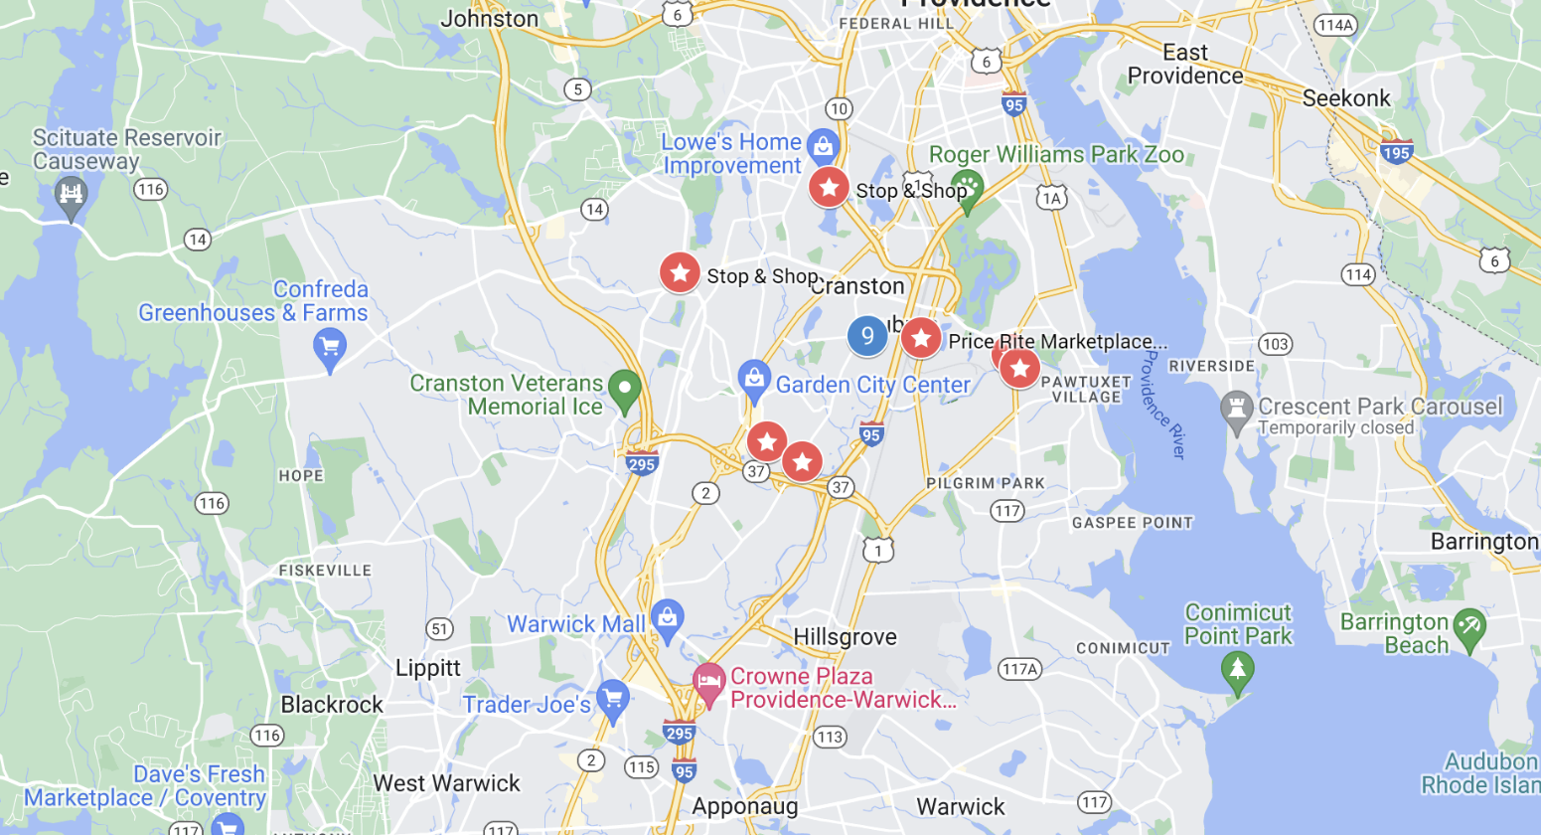

Sales Comparables
HIGHLIGHT HOW THE PROJECTED EXIT VALUE, CAP RATE, AND PRICE PSF COMPARE AGAINST COMPARABLE SALES IN THE AREA. IF APPLICABLE, YOU MAY WISH TO CREATE A SIMILAR SLIDE FOR LAND COMPARABLES AS WELL
Comp 1
Comp 2

Slide 17
Additional Appendix Content Suggestions
The appendix is ideal for detailed or technical information that is not central to your presentation's narrative but may be of interest to more specialized audience members or those seeking more depth. It allows you to maintain a smooth and focused presentation while providing full transparency and additional detail for those who wish to delve deeper.
Detailed Lease Information: Include specifics of any major leases, including tenant profiles, rent rates, and lease terms.
Capital Expenditure Details: Breakdown of anticipated capital expenditure, with estimates from contractors or price quotes, if available.
Additional Architectural and Planning Documents: Detailed maps, floorplans, architectural designs, renderings, and other related documents.
Zoning and Regulatory Details: Comprehensive information on local zoning regulations, parking requirements, and other relevant regulations.
Supplementary Market Analysis: Additional data or analysis on market trends, comparables, and local demographics.
Detailed Financial Projections: More extensive financial models and projections that support the summary data in the main deck.
Property Management Details: Information about the property management strategy and team.
Environmental and Sustainability Factors: If applicable, information on the environmental impact and sustainability measures related to the property.
Risk Analysis: More detailed risk assessments and mitigation strategies.
Additional References: Any relevant data or information that supports your proposal but does not fit naturally into the main presentation.

Slide 18
Site Photos (Place Additional Site Photos Behind this Slide)

Slide 19
Photo Credits
Photo by Expect Best: https://www.pexels.com/photo/low-angle-view-of-office-building-against-sky-323705/
Photo by SevenStorm JUHASZIMRUS: https://www.pexels.com/photo/gray-red-and-orange-concrete-building-439391/
Photo by George Becker: https://www.pexels.com/photo/photography-of-orange-and-gray-building-129494/
Photo by Pixabay: https://www.pexels.com/photo/turned-off-flat-screen-tv-276724/
Photo by Vecislavas Popa: https://www.pexels.com/photo/white-wooden-modular-kitchen-1643384/
Photo by Miguel Á. Padriñán: https://www.pexels.com/photo/white-and-teal-concrete-buildings-434139/
Photo by Pixabay: https://www.pexels.com/photo/apartment-architecture-building-buildings-259781/

